Slide 1
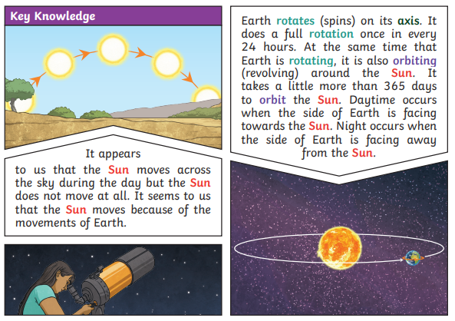
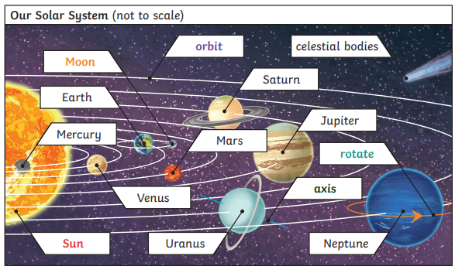
Earth and space
Science
Year 5/6
Autumn 1
Cycle B
Overview
During this topic we will be discovering that the Earth (our planet) is a part of the Solar System. At the centre of the Solar System is the Sun. We will learn what it takes to be a great scientist. We will be learning about the phases of the Moon. We will be exploring the Earth, Sun and Moon orbits. We will also be researching famous scientists linked to space exploration and gain knowledge of the history of the moon landing.
Key Questions
What is the sun? What is a moon?
Can you describe how the Earth moves around the sun?
How many planets are there in our solar system?
How does the Moon move around the Earth?
Can you explain day and night using the idea of Earth’s rotation?
Scientific enquiry
In this topic we will:
Identify scientific evidence that has been used to support or refute ideas or arguments.
Report and present findings from enquiries, in oral and written forms such as displays and other presentations.
Investigation
As part of our investigation we are going to design a rocket and solar system models. This is a cross curricular link to Design and Technology.
Topic vocabulary
Solar System: The sun and everything that orbits it. This includes the eight planets and their moons, dwarf planets, asteroids, comets, other small objects and all the empty space in between them.
Orbit: A repeating path that one object in space takes around another. All orbits are elliptical in shape, meaning they're egg-shaped, or oval, rather than circular.
Rotate: When something turns or spins around a point located in its centre.
Axis: An imaginary line an object turns around. This imaginary line runs directly through the object's centre, from the north to the south poles.
Sphere: A 3 dimensional object shaped like a ball.
Waxing: The process of increasing how much of the moon is lit (as observed night to night) i.e. it’s headed towards being a full moon.
Waning: The process of decreasing how much of the moon is lit (as observed night to night) i.e. it’s headed towards being a new moon.
Satellite: A smaller object that orbits, or revolves around, a larger object in space. Satellites can be natural or artificial (made by people).
Celestial body: A naturally occurring object that exists in the observable universe. Geocentric model: A model of the universe with the Earth at the centre and all other celestial bodies orbiting it.
Heliocentric model: A model of the solar system with the Sun at the centre and all other celestial bodies orbiting it
Knowledge & Understanding
In this unit, the we will:
Describe the movement of the Earth, and other planets, relative to the Sun in the solar system
Describe the movement of the Moon relative to the Earth
Describe the Sun, Earth and Moon as approximately spherical bodies
Use the idea of the Earth’s rotation to explain day and night and the apparent movement of the Sun across the sky

