Slide 2
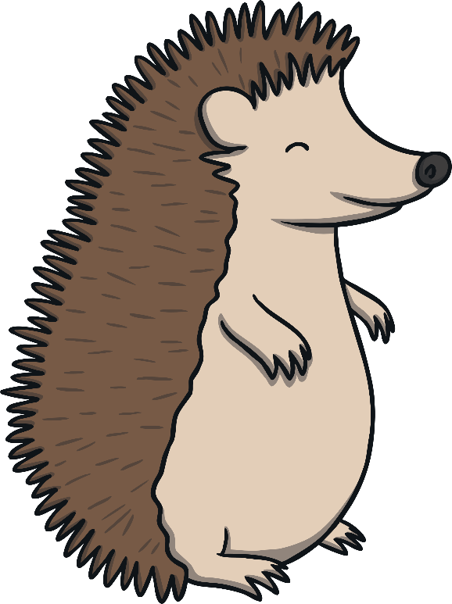
What Does It Mean?
Can you guess what this word is before all the letters are revealed?
H
a
b
i
t
a
t
. Do you know what the word habitat means?
A habitat is the place where a living thing lives.
A habitat must have the food, water and space
that a living thing needs.

Slide 3
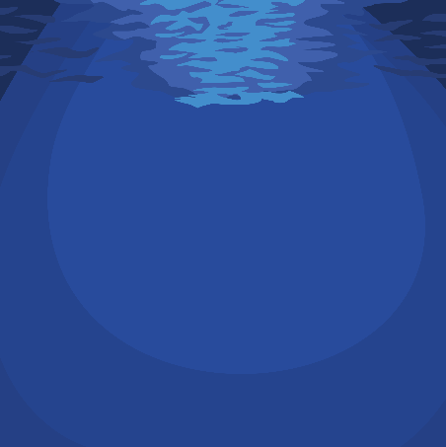

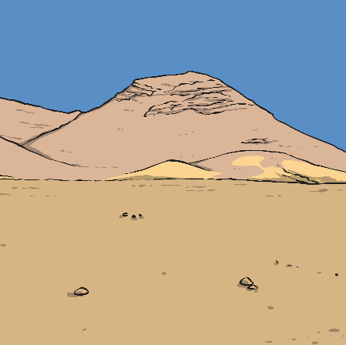
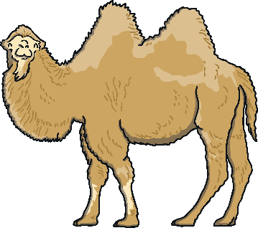
Habitats
Living things are suited to the place where they live, their habitat. Look at each of these creatures. Talk about where they live and why they are suited to it.
Clownfish live in the sea. Fish breathe in the water. They live next to creatures called anemones and eat leftovers from anemones.
Camels live in the desert where there isn’t much food. Their humps can store fat to live off until they can get food. Camels have long eye lashes to protect their eyes from sand storms.

Slide 4
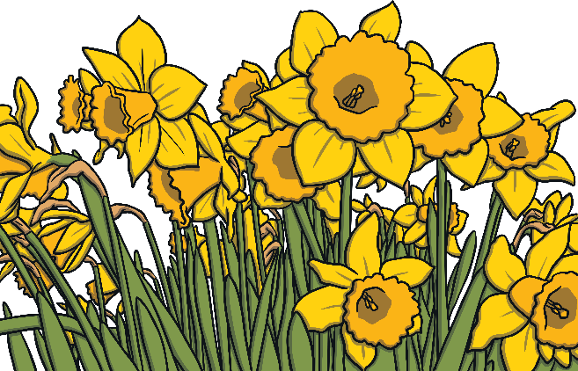
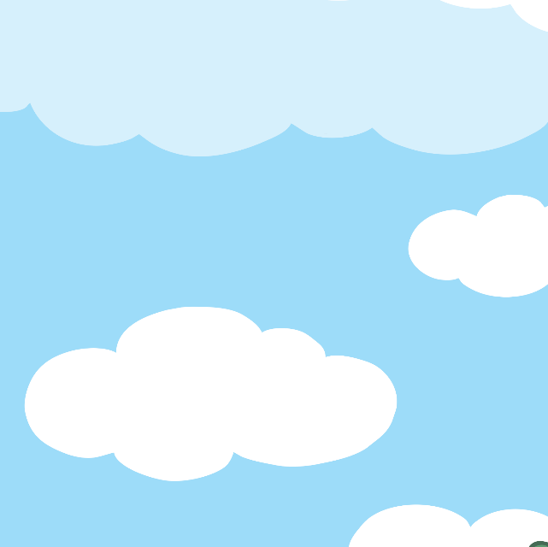
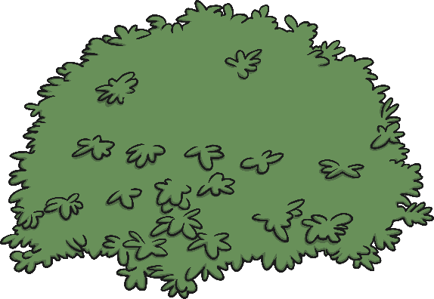

Plant Habitats
Talk About It
What different plants can you think of?
Just like animals, plants have habitats.
They are suited to the place where they live.

Slide 5
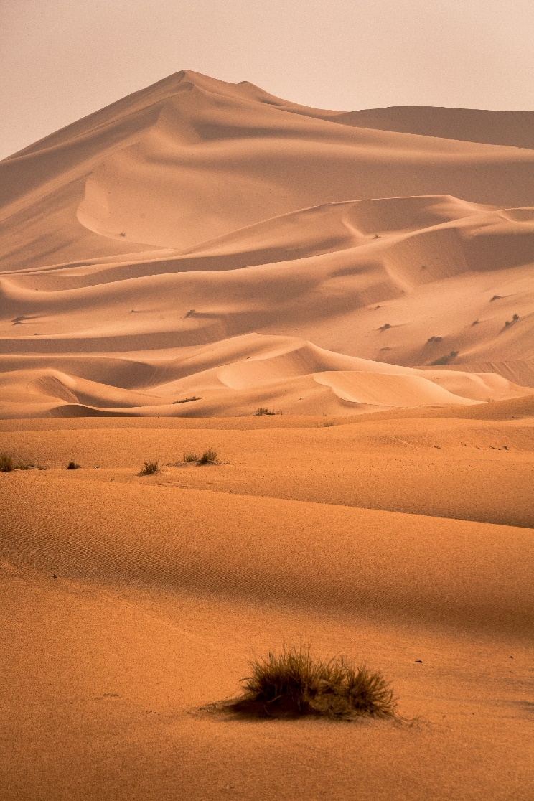
Deserts
A desert is a hot dry place where not many plants can grow.
Cacti can survive in the desert because they have a lot of shallow roots which collect any small amount of water in the ground. Their stems can store this water for a long time.
The desert is the habitat of a cactus. More than one of these plants are called cacti. There are over 2,000 different kinds of cacti. Some of them live in the Atacama Desert, one of the driest places in the world.
The spikes on cacti are actually leaves. They protect the plant from being eaten by animals. The spikes also stop air flowing near the cactus, which keeps water in.

Slide 6
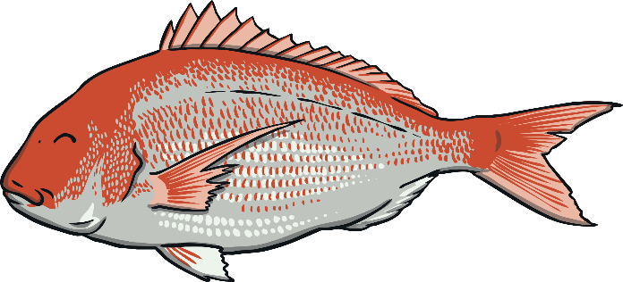
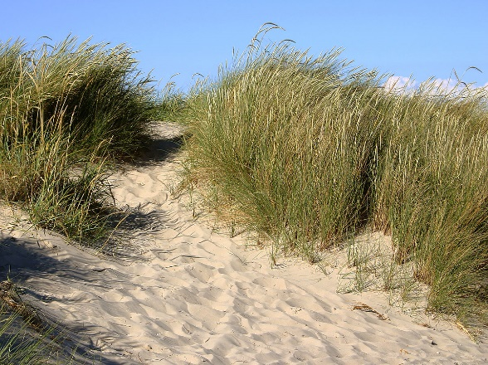
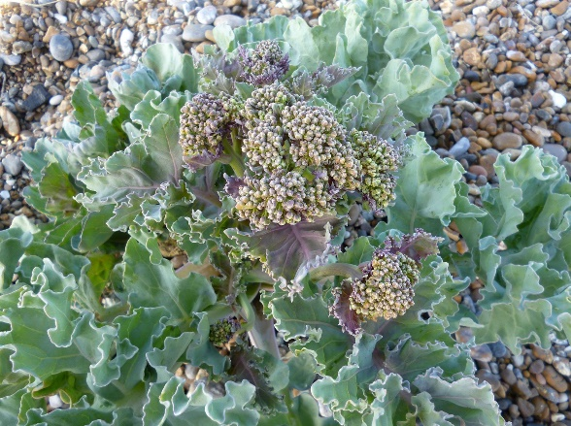
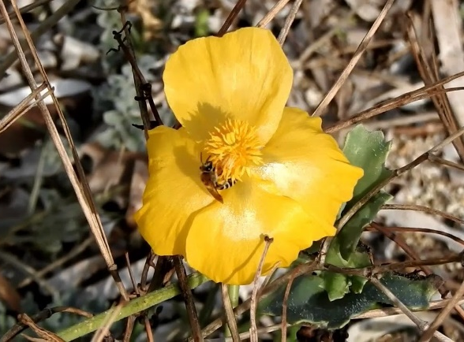
The Seaside
Plants that live at the seaside need to be able to survive in strong winds, bright sunshine, salty air and shallow sandy soil.
Talk About It
Have you been to the seaside?
What plants did you see there?
Beach Grass
Sea Kale
Horned Poppy

Slide 7
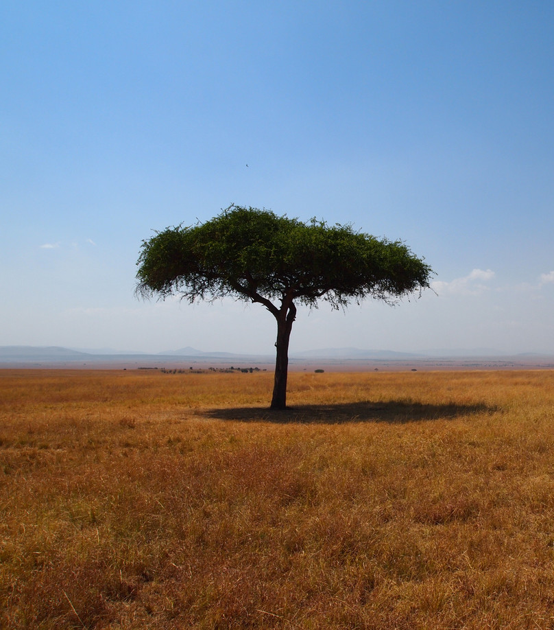
The Savana
The savanna is a large area of grassland in Africa. Animals such as lions, wildebeest, zebras and giraffe live in the savanna.
However, during other parts of the year, there are heavy rains. Trees have thick trunks to store some of this water to use during the dry season.
For a lot of the year, savannas are hot and dry. Plants that grow on the savanna have to have long deep roots to reach underground water. Because there is no rain, there are often fires on savannas. Savanna trees have thick bark to protect themselves from these fires.
An umbrella acacia tree
growing on the savanna.

Slide 8
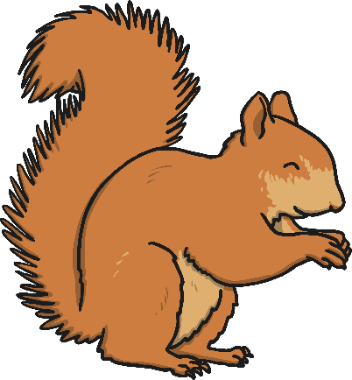
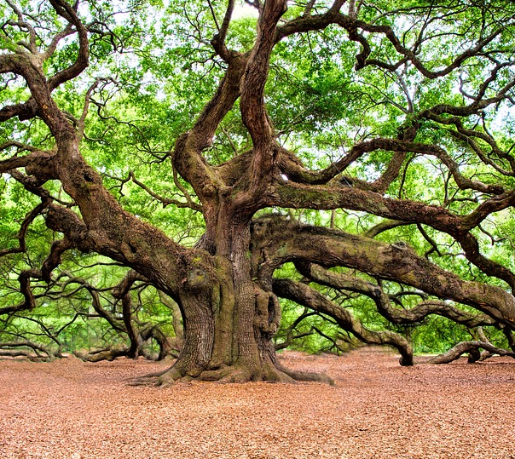
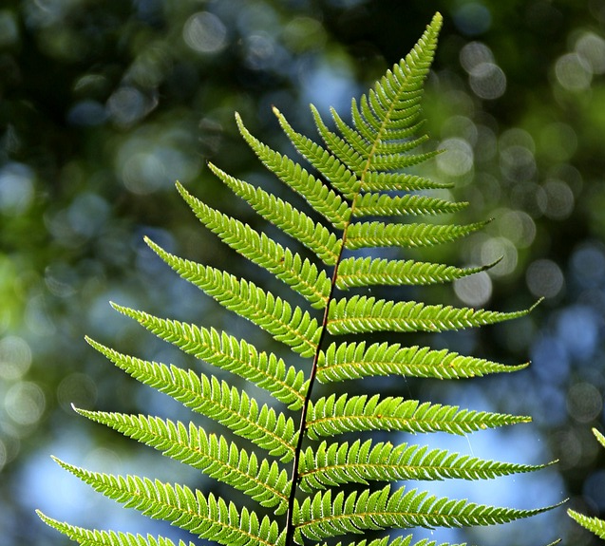
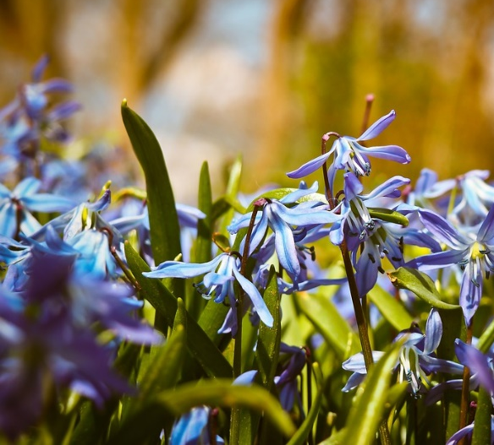
Woodlands
Talk About It
Have you ever been in a forest?
What could you hear, see and smell?
You might find these plants in a woodland.
Oak trees
Ferns
Bluebells

Slide 9
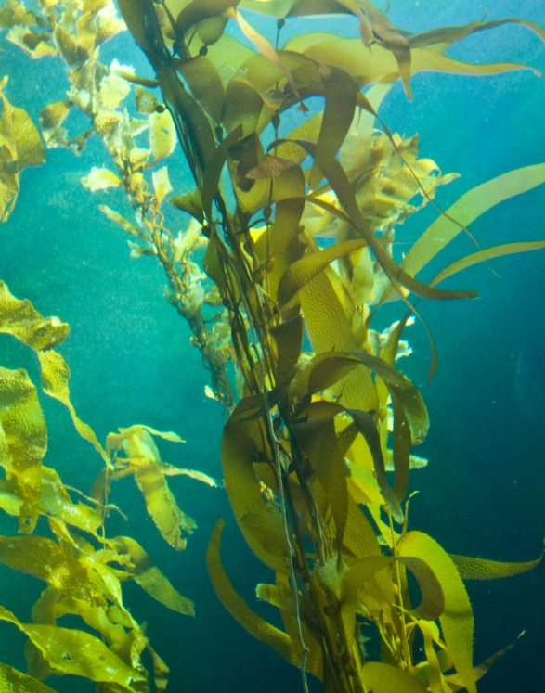
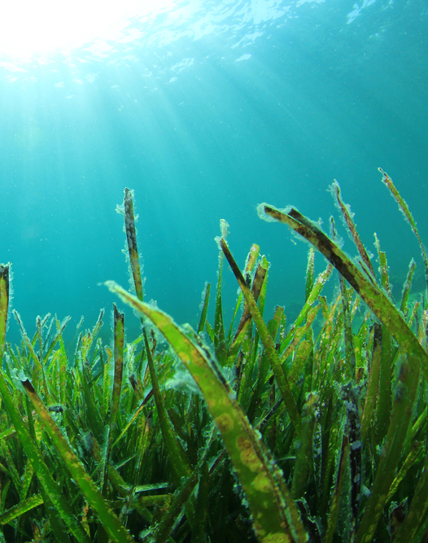
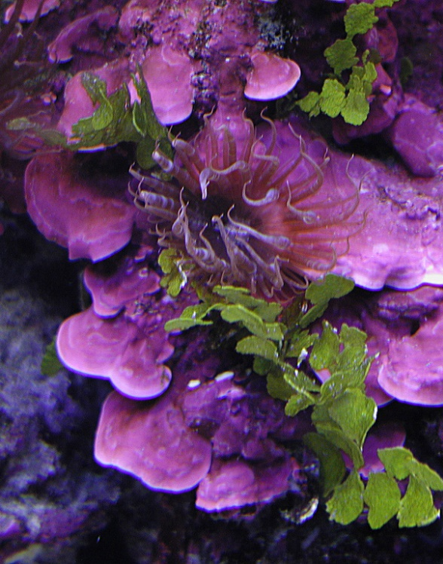
Under the Sea
Plants need at least some sunlight to grow, so in the deepest parts of the sea, plants can’t grow. However, in more shallow water, plants can grow. Some plants float on the surface of the water to get sunlight.
Kelp is one of the fastest growing plants in the world.
Sea grass needs lots of sunlight so only grows in
shallow water.
Coralline algae grows on coral in warm seas.

Slide 10


What Have We Learnt?
A habitat is the home of a living thing.
Plants are suited to their habitats because the habitats have everything that a particular plant needs to grow well.
Plants wouldn’t grow well in different habitats.

