Slide 1
Seasons

Slide 2
Seasons
The year can be split into 4 different seasons.
Can you name the different seasons?
Spring
Summer
Autumn
Winter

Slide 3
Seasons
Spring?
Which months are in
March
April
May

Slide 4
Seasons
Summer?
Which months are in
June
July
August

Slide 5
Seasons
Autumn?
Which months are in
September
October
November

Slide 6
Seasons
Winter?
Which months are in
December
January
February

Slide 7
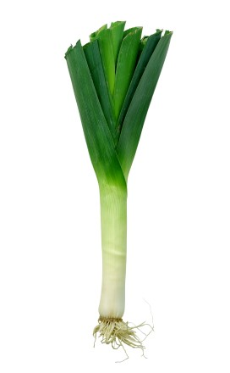
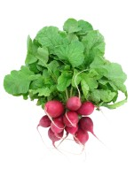
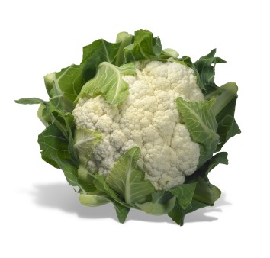
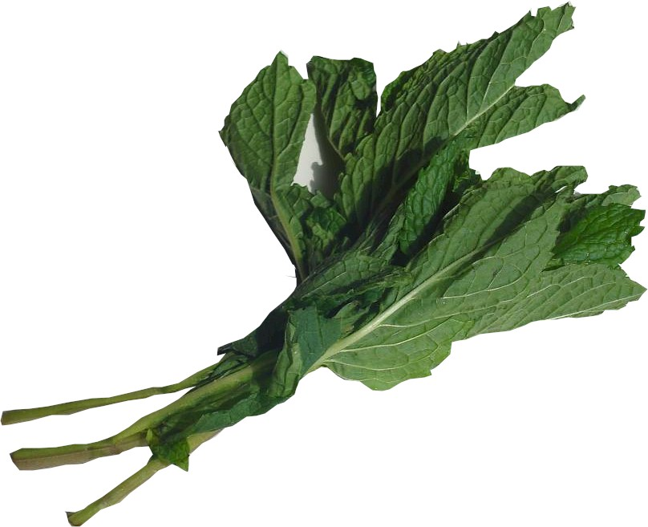
What foods are ready to eat in…
Spring?
Radishes
Cauliflower
Mint
Leeks

Slide 8
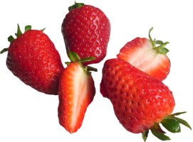
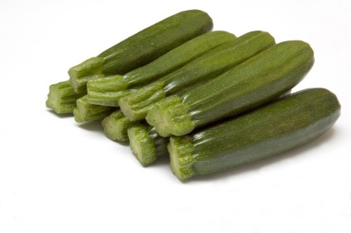
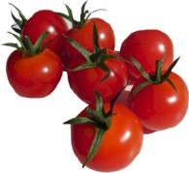
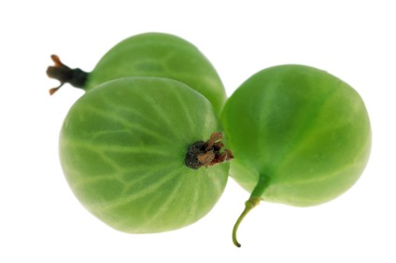
What foods are ready to eat in…
Summer?
Strawberries
Courgettes
Gooseberries
Tomatoes

Slide 9
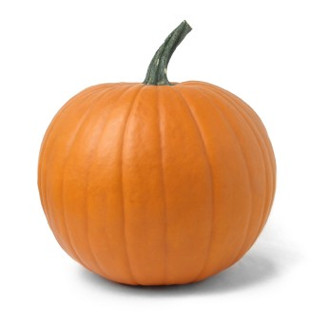
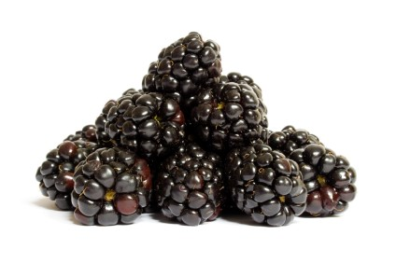
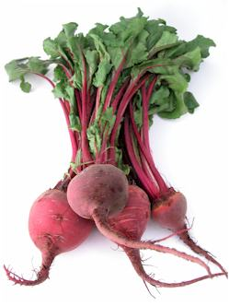
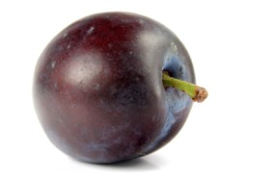
What foods are ready to eat in…
Autumn?
Blackberries
Pumpkins
Beetroot
Plums

Slide 10
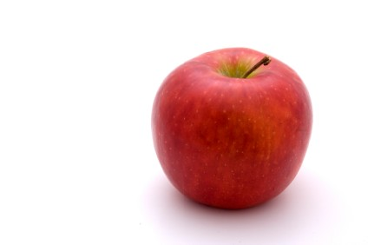
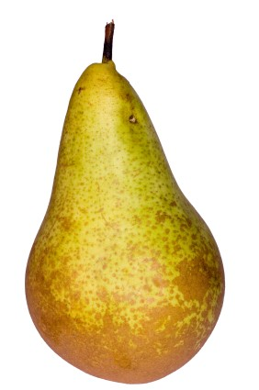
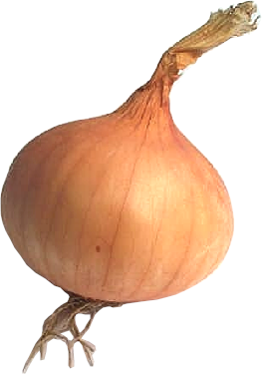
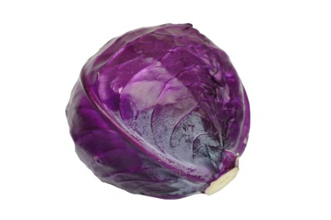
What foods are ready to eat in…
Winter?
Apples
Pears
Red cabbages
Onions

Slide 11
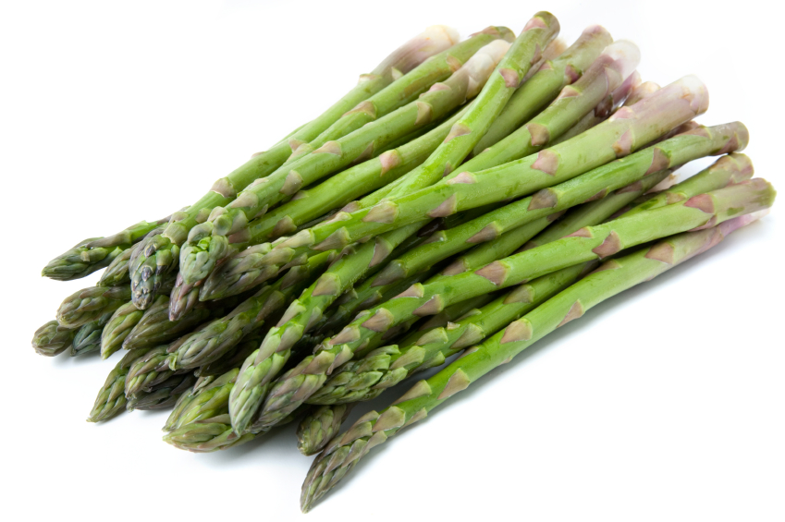
Seasons
We can still get a lot of these foods when they are not in season.
Do you know how?

Slide 12
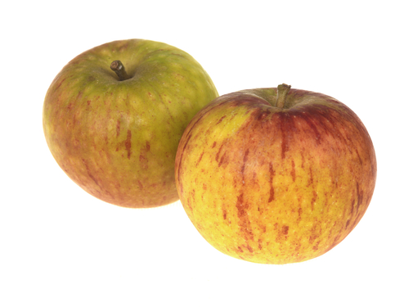
Seasons
Some food can be stored until it is needed.
Apples can be kept in a cold store for several months.

Slide 13
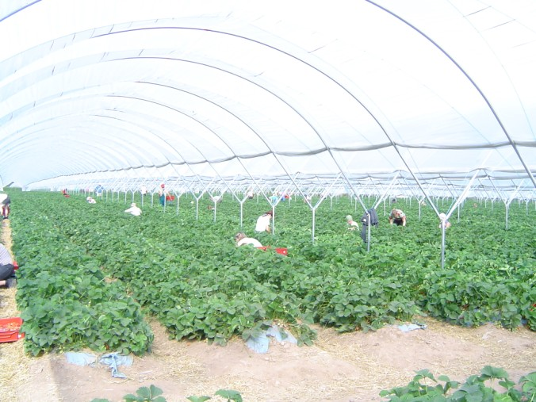
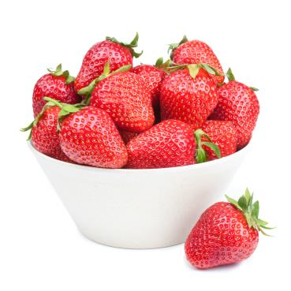
Seasons
Some foods are grown in plastic tunnels or glass houses.
This means foods can be ready at different times than it would be if it was growing outdoors.

Slide 14
Seasons
Some foods comes from other countries.
In some countries the weather and seasons are different from the UK so we can get food from these countries when we cannot get it here.
This asparagus is from Peru. Asparagus is ready in May in the UK.

Slide 15
For further information, go to:
www.foodafactoflife.org.uk

