Slide 1
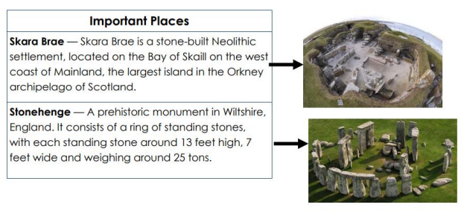
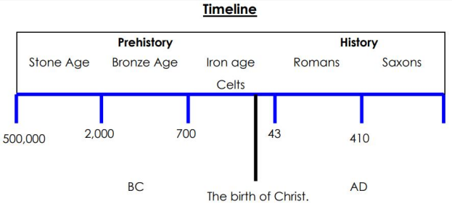
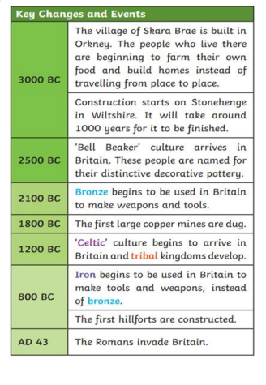
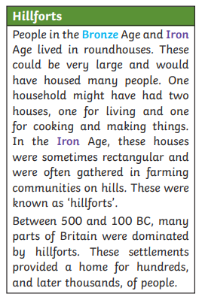
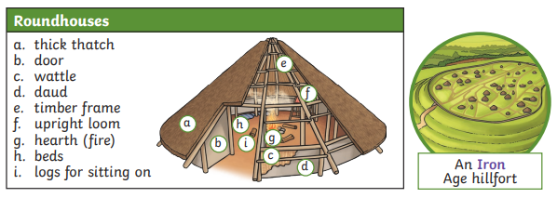
Stone age to iron age
History
Year 3/4
Autumn 1
Cycle B
Cross Curricular links
Geography links
Locational and place knowledge
Locate key settlements
Identify major geographical features of settlements
Human and Physical
How does the location affect / influence where the settlements are and their lifestyle?
Geographical skills and field work
Use maps, atlases, globes and digital media to locate countries
Use four figure grid references
Science links
Learning about rocks and soils
Art links
Stone age art, cave paintings
Design technology
Construction
Research, design and make models of prehistoric buildings
Overview
During this topic we will be discovering that the Stone Age is named after the stone tools that the earliest humans used to help them survive. They used them to kill animals, such as mammoths, for their meat, bone marrow and skins. The bones were also useful for making tools, such as needles to sew skins together. People in the Stone Age moved around from place to place with the seasons, in order to keep safe and warm and to follow the animals they hunted. We are also going to be learning about iron age forts, farming, arts and culture.
Topic vocabulary
Bronze A metal alloy made from a mixture of copper and tin. It is a much harder and more long-lasting material than stone or copper alone.
Alloy A metal made by combining two or more metals to improve its properties.
Bone marrow The substance inside bones, which is high in fat and a good energy source.
Earthwork A large bank or mound of soil that has been made on purpose.
Celt A modern term for the people living in Europe during the Iron Age. The ‘Celts’ were made up of many different tribes. The word ‘Celt’ comes from a Greek word.
Sacrifice To give something up, break it or kill it as an offering to a god or gods. T
Tribe A group of people, often related through family, culture and language, usually with one leader.
Iron A metal that is stronger and harder than bronze.
Knowledge & Understanding
In this unit, the we will:
Gain an increased understanding of chronology
Describe changes in Britain from the Stone Age to the Iron Age.
Know that the Stone Age is named after the stone tools that the earliest humans used to help them survive.
Know that the Bronze age and Iron age were named after the discovery of these metals and used to make tools.
Describe how people lived in each period.

