Slide 1
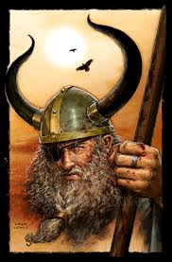
Odin
LKS2 Topic: Invaders and Settlers - Vikings Block E: Mythology, Art and Culture Session 3
Odin was the chief god in the Norse mythology, and the father of Thor, Balder, Hoder, Tyr, Bragi, Heimdall, Ull, Vidar, Hermod and Vali.
Odin was the god of magic, poetry and war.
His wives were Fjorgyn, Frigga and Rind.
© Original resource copyright Hamilton Trust, who give permission for it to be adapted as wished by individual users.
We refer you to our warning, at the foot of the block overview, about links to other websites.

Slide 2
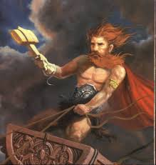
Thor
Thor was the son of Odin and Fjorgyn.
Red-headed Thor ruled the skies, storms and thunder.
He had iron gloves, a magic belt and a hammer, Mjölnir.

Slide 3
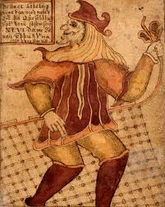
Loki
Loki can be called the 'wizard of lies' and is in many ways the most interesting god in Asgard.
Loki was related to Odin, through a strange blood-brotherhood.

Slide 4
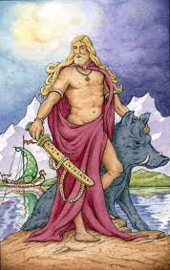
Frey
Frey was a fertility god of the the Vanir race.
He was the son of Njord and came to Asgard as a hostage along with his father and sister Freyja.

Slide 5
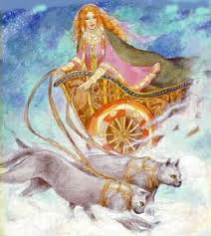
Freyja
Freyja was goddess of love and fertility.
She wept golden tears when she was unhappy.

Slide 6
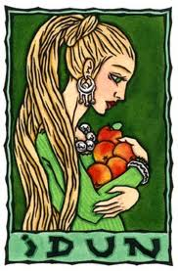
Idun
The goddess of spring and immortal youth was called Idun.
She was the daughter of the dwarf Ivald and married to the god Bragi.

Slide 7
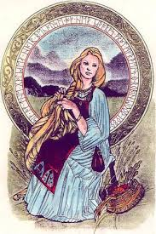
Sif
Sif was the goddess who married Thor.
She had golden hair.

Slide 8
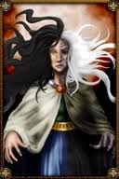
Hel
Hel was a goddess.
A daughter of Loki and Angrboda, who ruled over Niflheim, which was the land of the dead.
There were different opinions of whether she was alive or dead.

Slide 9
Fact File
Name: _____________ Picture
Key facts:
_____________
_____________
_____________
_____________
Why I chose this god?
________________
________________

