Slide 1
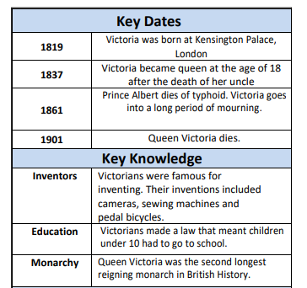
Toys
History
Year 1/2
Autumn 2
Cycle B
Overview
During this topic we will be discovering that toys have existed for thousands of years. They were made out of the materials that were available at the time. Even stone and string have been made into toys. Toys were mainly made of wood, paper and metal during the Victorian age.
Key Questions
What are toys used for?
How long have toys existed?
What materials are toys made from?
How are modern toys different?
Can you find out
What was your first ever toy?
What toys did your parents and grandparents play with?
Cross Curricular links
Design Technology
Mechanism
Research, design and make a toy with moving parts (eg a robot) based on exploring toys
Art and design
Observational drawings of toys
Topic vocabulary
Victorian toys – are toys that were played and made when Queen Victoria reigned
Modern toys – toys that have been made recently
Timeline – an order of events placed on a line.
Chronological – putting events in date order. Toy – object that we play with
Past – having happened
Present – existing now
Materials – what something is made from
Old – belonging in the past
Handmade – made by someone
Factory made – made in a factory
Compare – to say what is different or similar
Knowledge & Understanding
In this unit, the we will:
use the terms past, present and future
Order objects into those from the past and those from the present
Create a time line of my own life and time lines for the lives of significant people from the past
Identify toys from the past and what materials they were made from
Compare the lives of Victorian children to my own life
Explain who Queen Victoria was and compare her to Queen Elizabeth II
Use primary and secondary sources of evidence to find out about toys from the past

