Slide 1
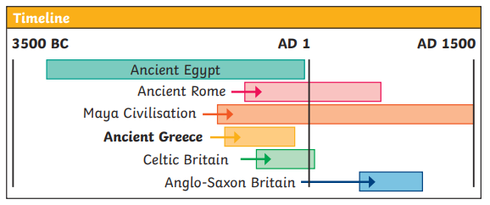
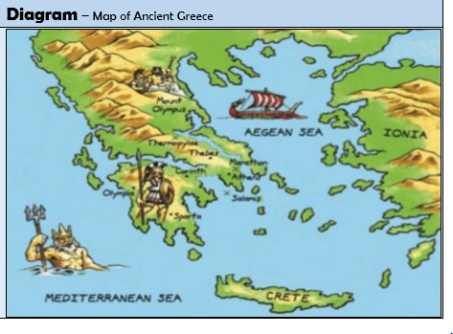
Ancient Greece
History
Year 5/6
Autumn 1
Cycle B
Overview
During this topic we will be discovering that ancient Greece is important historically because many things in culture today, especially in modern Europe, have been influenced by the ideas of the ancient Greek civilisation. The sculptures, architecture, philosophy, arts, politics and the scientific and mathematical ideas of ancient Greece are just some of the things that have had a significant impact on culture today. These things can be referred to as ‘legacies’ of ancient Greece. We are going to be learning about the Olympic games and the story of the Elgin Marbles and how has this affected relations with the UK.
Cross Curricular links
Geography
Locational and place knowledge
Locate Greece and its major geographical features
Human and physical
How does the climate affect / influence its trade?
Geographical skills and fieldwork
Use maps, atlases, globes and digital media to locate countries
Use four and six figure grid references
Topic vocabulary
Ancient Something from a very long time ago. Civilisation In this context, the word ‘civilisation’ is used to describe a human society with well-developed rules and government, often where technology and the arts are considered important.
City states Small areas that ancient Greece was divided into, each with their own governments, laws and army.
Empire A group of countries or states that is ruled by one ruler or country.
Legacies Things that live on after someone dies or after a civilisation or event ends.
Democracy A system where the citizens of a country or state are involved in the way it is run.
Primary source Information and objects that come from the time being studied.
Secondary source Interpretations of information and objects which are produced after the time being studied.
Knowledge & Understanding
In this unit, the we will:
Locate Ancient Greece in time and place and identify it’s ‘Golden Age’.
Explore evidence regarding an Ancient Myth.
Explain the main features of Ancient Athenian society
Draw inferences from evidence.
Use different sources to find out what life was like for women in Ancient Greece.
Explore how democracy worked in Ancient Greece.
Explore the Ancient Greek’s legacy.
Greek geography
Greece is made up of the mainland and many islands.
Its position by the sea meant that the Greeks were a seafaring people.
City-states (polis) were created and trade happened between each of the cities.
Greece is a warm country, but winds from the Mediterranean, and rains from the north, kept temperatures liveable and created fertile farming conditions.

