Slide 1
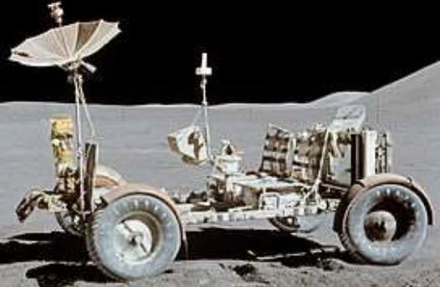
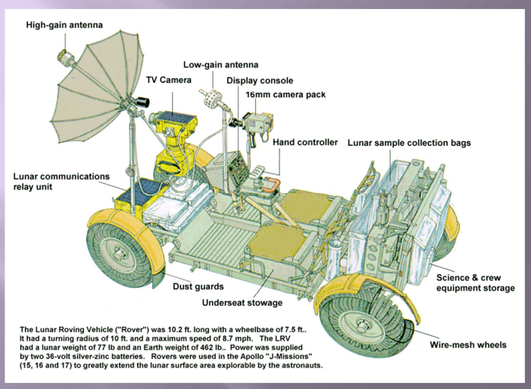
Moon buggy
Design Technology
Year 5/6
Autumn 1
Cycle B
Overview
During this topic we will be discovering that the Lunar Rover was specially designed to travel in low gravity on the soft surface on the moon- it was tested on sand! 4 rovers were built altogether – costing $38 million! It was designed to carry two astronauts, equipment and moon rock samples. Lunar Rover is 3 metres long and 1metre high. It is powered by two 36V batteries. The Lunar Rover was designed to travel at 8 miles per hour, but the astronauts raced it to 11mph on it’s last journey! It was folded up to fit in to the rocket which took it to the moon. It has a colour video camera to record. It has a large dish antenna to send pictures back to Earth. The buggy can also be controlled by NASA Mission Control. It is steered by pulling a handle forward, back, left and right.
Topic vocabulary
Cross Curricular links
Science
Earth and space
Did you know that
NASA are planning to send a team of astronauts to the moon again in 2024? They have promised the team will include at least one female, who will become the first woman to go to the moon. The crew will set up a base that can be travelled to again and again!
Knowledge & Understanding
In this unit, the we will:
Make and use simple series circuits
Understand and use mechanical systems e.g. pulleys, wheels, axels and bearings.
Build and reinforce structures

