Slide 1
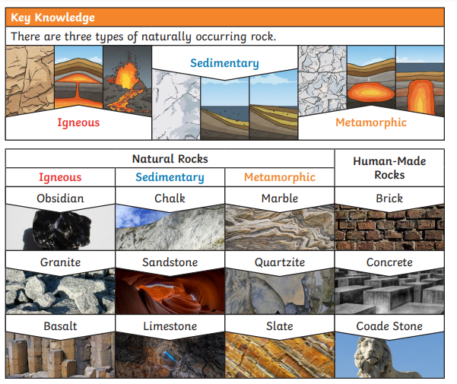
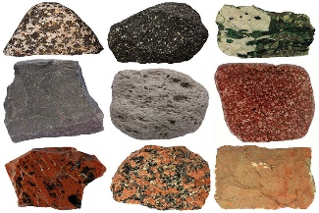
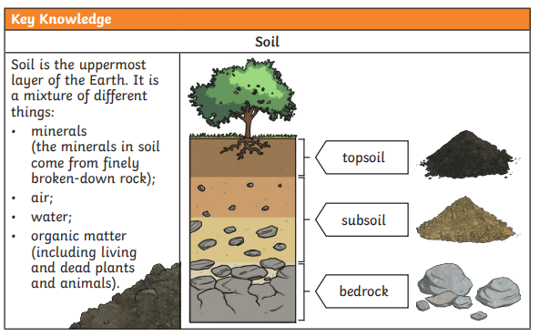
Rocks
Science
Year 3/4
Autumn 1
Cycle B
Overview
During this topic, we will be discovering different types of rocks and how they are formed. We will compare and group them based on their properties. We will also be learning about fossils and soil and how they are formed.
Key Questions
What is a rock?
How do rocks change over time?
Why do rocks change over time?
How are fossils formed?
What is soil made of?
Investigation
We are going to carry out an investigation into hardness of rocks, permeability and differences in soil.
Scientific enquiry
During this unit we will:
ask questions
make predictions
record findings
Knowledge & Understanding
In this unit, we will:
Compare and group together different kinds of rocks on the basis of their appearance and simple physical properties
Describe in simple terms how fossils are formed when things that have lived are trapped within rock
Recognise that soils are made from rocks and organic matter.
Topic Vocabulary
Crystals – clear colourless minerals
Fossils – the remains or impression of a prehistoric plant or animal embedded in rock and preserved
Igneous – rock that has been solidified from lava or magma
Metamorphic – rock that has been changed by extreme heat and pressure
Organic – matter that has come from
a recently living organism
Permeable – allows liquids or gases to pass through it
Sedimentary – rock formed from particles

