Slide 1
What is a diary?
A piece of writing that tells us about what you were doing or feeling at a certain time.
It is a way to record your thoughts.
© Original resource copyright Hamilton Trust, who give permission for it to be adapted as wished by individual users.
We refer you to our warning, at the foot of the block overview, about links to other websites.

Slide 2
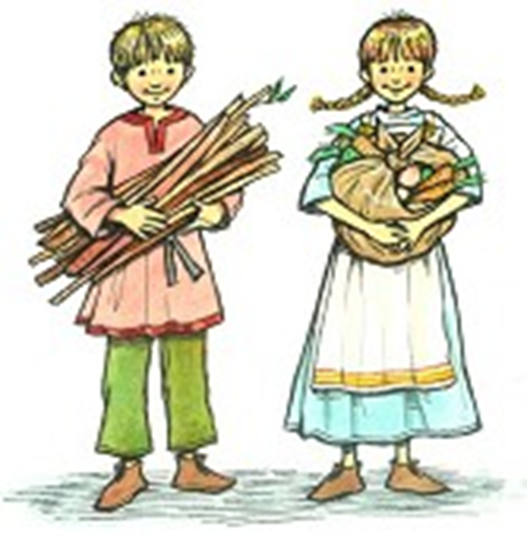
Imagine you are a child in Viking times…

Slide 3
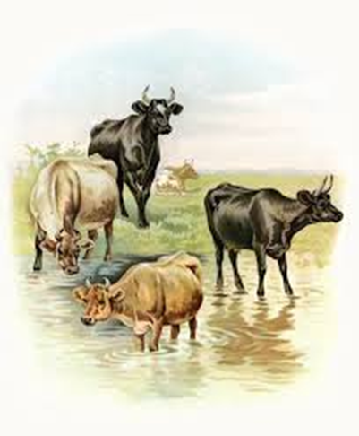
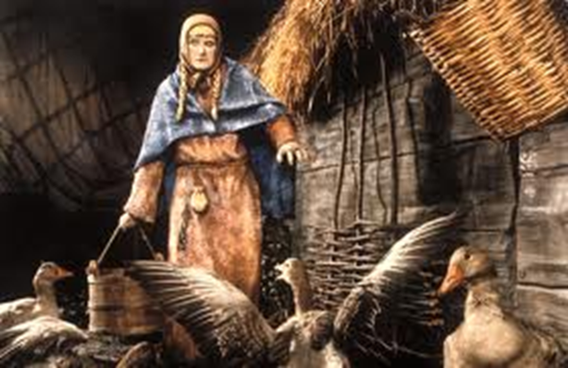
You work hard every day!
You wake up really early in the morning to feed the animals and help your parents to milk the cows and collect eggs from the chickens.

Slide 4
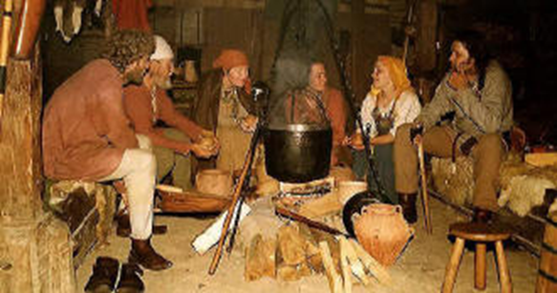
You only eat two meals a day
Everything you eat you make from scratch or kill it yourself.

Slide 5
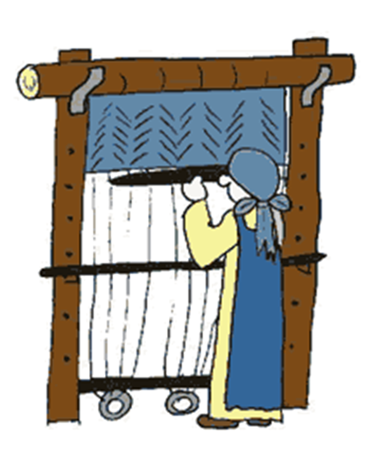
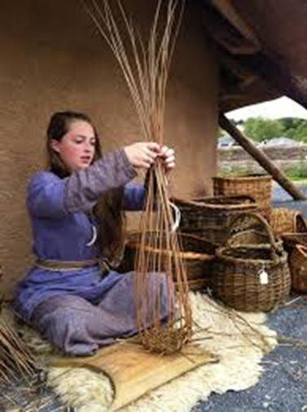
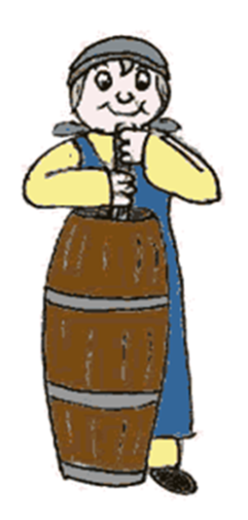
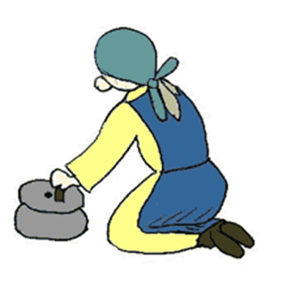
You work hard all day long

Slide 6
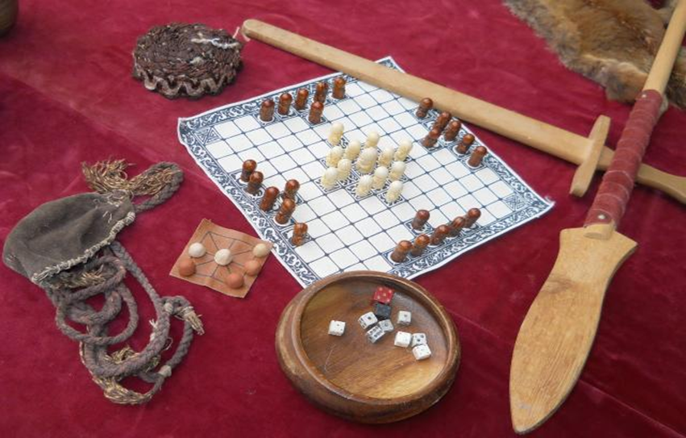
Not much time for play
But when you’ve finished your work..
Or listen to stories about history and religion.

Slide 7
Write a diary entry about your day.
What you did in the morning.
What you did in the middle of the day.
What you did in the evening (after work).

Slide 8
You should say..
What you have been doing.
This morning I have been working hard helping mom to feed the chickens.
How you are feeling.
I am happy today because I practiced my fighting with my cousin. I am getting really good.
I am tired, I worked hard all day weaving baskets.

Slide 9
You should use.
‘I’ , ‘we’ : You are talking about yourself.
Verbs: Walked, worked, jumped, fought, ate, slept.
Examples of events that happened during your day.
Remember you are pretending to be a Viking child!

Slide 10
08:00am: Dear diary, this morning I woke up at 6 o’clock. I helped mom feed the chickens. We worked hard for two hours. I am very hungry now, mom is making breakfast on the fire. She is making delicious porridge.
03:00pm: Dear diary, I am really tired. I have spent all afternoon making a new dress for my mother. I hope she likes it. My hands are tired and now I have to help my aunty to weave some baskets.
08:00pm: Dear diary, I am getting ready to go to sleep. I have had a busy day. I played ‘Kingy bats’ with my brother after our dinner of wild boar and cabbage. Dad and my uncle are telling stories about Thor beside the fire. I am going to sleep on my blanket that I made from sheep skin. It’s so cosy.

Slide 11
4th March 889
08:00 am: Dear diary,
03:00pm: Dear diary,
08:00pm: Dear diary,

Slide 12
You will be successful if:
You use the features of diary entries.
You pretend to be a Viking child.
You give lots of examples of what a Viking child does every day.
You write neatly.
You work quietly.

