Slide 1
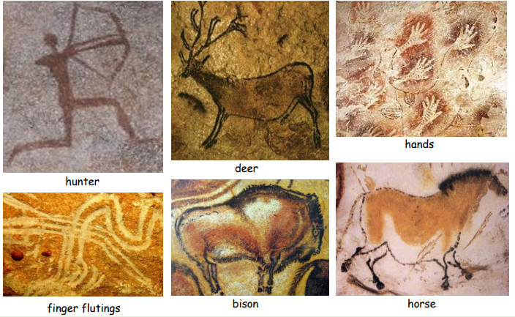
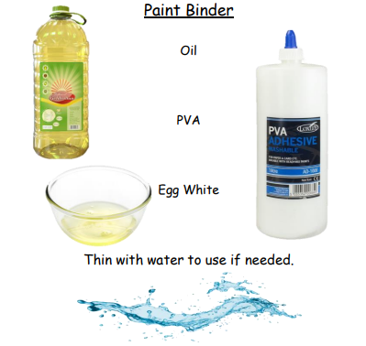
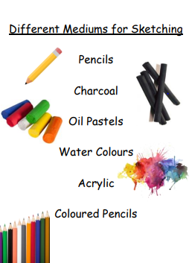
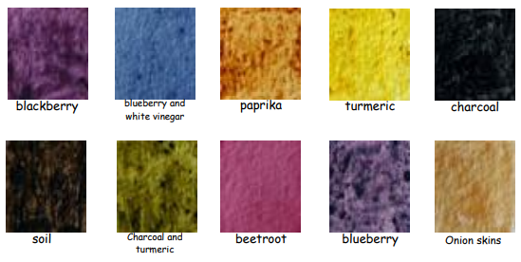
Cave art
Art and Design
Year 3/4
Autumn 1
Cycle B
Overview
During this topic we will be discovering that cave paintings are paintings on cave walls and ceilings. These paintings were made in pre-historic times. Most cave paintings date from 10,000 to 20,000 years ago. It is not known why these paintings were made. Most people think they had a function for rituals or as a way of sharing information. Most paintings are in caves that are difficult to access. These caves usually do not show signs that people lived there all year round.
Today, there are about 350 caves known to have paintings in them. Many are in France and Spain. The best known are the caves of Altamira (Spain), Lascaux (France) or Creswell Crags (England). Sometimes, paintings were also done on cliff faces, however due to erosion fewer of these paintings have survived. An example of rock painting on cliff faces can be found at Astuvansalmi (Finland). Most often animals or hunting scenes were painted, although sometimes hands were painted too. The paintings were drawn with red and yellow ochre, hematite, manganese oxide and charcoal.
Did you know that natural materials can be used to create different colours?
Which colours do you think are hardest to achieve?
Which colours would be the most suitable for your stone age art?
Topic vocabulary
Pigment – a substance used for colouring or painting, especially a dry powder, which when mixed with oil, water, or another medium constitutes a paint or ink.
Binder – refers to substances that hold the particles of pigment together in paint. All paints include a binder of some sort because this is what keeps the pigment in place after the paint dries.
Swatch – applying a sample of paint to a surface to test or demonstrate the colour.
Prehistoric -the time before recorded history Composition- ‘Putting together’. The placement of things in a piece of art.
Cave art - art painted on the walls of caves.
Knowledge & Understanding
In this unit, the we will:
Develop techniques, including control and use of materials, with creativity, experimentation and an increasing awareness of different kinds of art, craft and design.
Improve our mastery of art and design techniques, including painting.
We will learn about great artists in history.
Cross Curricular links
History
Changes in Britain from the Stone Age to the Iron Age

