Slide 1
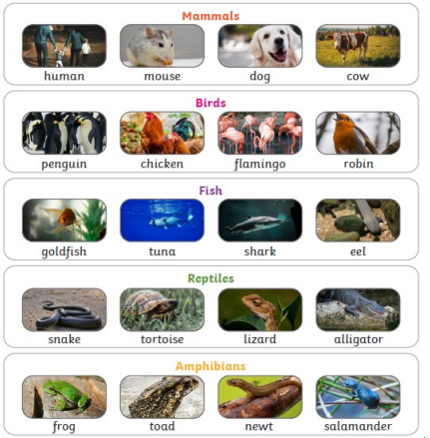
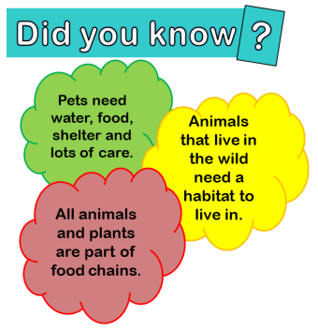
Animals including humans
Science
Year 1/2
Autumn 1
Cycle B
Overview
In this topic we will be discovering what a food supply chain is. We are going to be learning about human nutrition and exercise. We are also going to be learning about life cycles.
Key Questions
What do animals need to survive?
Can you describe how humans grow into adults?
How do animals get their food?
Can you describe life cycle of a …?
Scientific enquiry
In this topic we will:
Use observations to answer questions.
Identify, group and classify.
Investigation
As part of our investigation we are going to
Topic vocabulary
Pet- a tamed animal that is kept as a companion and looked after by its owner.
Mammal -any animal where the female produces milk to feed her babies.
Offspring -children or young from a parent.
Care - to look after something or someone.
Bird- creature with wings and feathers that is able to fly.
Fish- a cold-blooded animal that lives in water. Reptile- a cold-blooded animal such as a lizard. Amphibian an animal that can live in water and on land.
Knowledge & Understanding
In this unit, we will:
Notice that animals, including humans, have offspring which grow into adults
Find out about and describe the basic needs of animals, including humans, for survival (water, food and air)
Describe the importance for humans of exercise, eating the right amounts of different types of food, and hygiene

