Slide 1
Hepworth Class
What to expect in UKS2

Slide 2
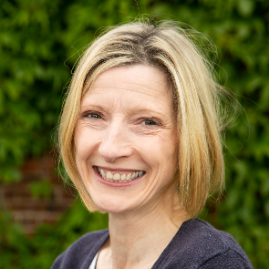
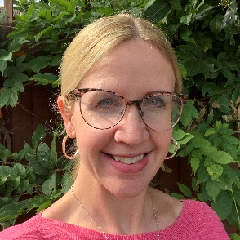
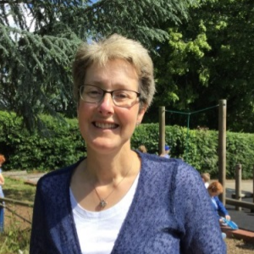
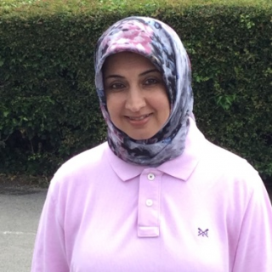
Our UKS2 Team
Mrs Jones
Class Teacher
Monday - Wednesday
Mrs Wilson
Class Teacher
Thursday - Friday
Mrs Walker
Teaching Assistant
Monday-Thursday
Mrs Karim
Learning Support Assistant
Monday-Friday

Slide 3
Expectations in Hepworth
Increase in responsibilities
Increased ownership and expectations
Homework (see separate slide)
Organisation
Independence
Expectations across the curriculum – they are the same
Firm but fair… secondary school is looming
Our focus is for every child to achieve their full potential and to leave us ready and able to access the Year 7 curriculum.

Slide 4
Being organised…
Pencil Case Requirements:
2 HB writing pencils2 navy blue handwriting pens (not biro)
1 30cm ruler
1 pair of scissors
1 glue stick (this will need replenishing throughout the term)
1 sharpener (preferably with its own collecting pot)
1 rubber
For marking/editing work:
1 purple pen (biro/gel pen)
1 green pen (biro/gel pen)
1 pink/red pen (biro/gel pen)
We recommend the "Bic 4 colours fun (not original) retractable ballpoint pen" which has purple, green, pink and blue ink in one pen to save space.
Optional but useful
highlighters
1 pack of colouring pencils
Felt pens/gel pens for use in some lessons
In School Every Day
Named water bottle
Coat
Weather relevant extras e.g hat/suncream
Reading Record and book
Pencil Case
PE Kit

Slide 5
English in Hepworth
Guided reading
All children work discuss a text with a teacher weekly
Work is completed daily eg vocabulary work, reading, comprehension, writing
Quality texts
Usually 4 times a week
Daily English work
Work based around a text – quality texts
Topic linked where possible
Reading and comprehending the text
Grammar
Punctuation
Writing – based around writing for a purpose, using different genres
Standalone SPAG (Spelling, punctuation and Grammar) lesson each week (Fridays)

Slide 6
Maths in Hepworth
Daily Maths lesson
We work through a strand at a time, until February
Number & place value, Four operations, Decimals, percentages & fractions
From February each teacher focusses on different strands eg Shapes, statistics, measures
We need to get the basics in place
Use of correct maths vocabulary
Use of different methods – one way is not perfect!
Explaining how, why, what if, I know…so I know
Everyday problems

Slide 7
Assessing
Termly for Year 5 (formally, but continuous teacher assessments)
Half-termly for Year 6 – to be ready for May Statutory assessments.
We scrutinise assessments to inform our planning
We identify ‘gaps’ to aid group teaching
We implement interventions, both individual and small groups
Terms used: Working at/towards ARE (Age Related Expectations) GD (Greater Depth)

Slide 8
End of KS2 Assessments
‘SATs Week’ is in May (8th – 11th May 2023)
Tests to be sat
Grammar Punctuation and Spelling – question paper (45 minutes) and spelling paper (20 spellings)
Reading Comprehension – 60 minutes
Maths – Arithmetic paper (30 minutes), 2 reasoning papers (40 minutes each)
Each child leaves Year 6 with a standardised score for each of the above
Working towards
At ARE (100)
Above 110 - considered Greater Depth
Reading ARE = >29 GD = >41 (out of 50 marks)
SPAG ARE = > 35 GD = >55 (out of 70 marks – across the two papers)
Maths ARE = > 58 GD = > 96 (out of 110 marks – across 3 papers)
To give an idea – raw scores in 2022 were:

Slide 9
End of KS2 Assessments
Writing – Teacher assessed at Working towards, at ARE or Greater depth
Science – Teacher assessed at Working towards or at ARE

Slide 10
What do the assessments look like?
The test are all based on using what the children have learned across KS2 (not just Year 6)
They check the children's knowledge and understanding
How the child can apply and use their learning is checked.
There a variety of question types in each subject and test
One word answers
Drawing lines
Writing sentences
Filling in boxes
Tick answers
Let’s look at some papers!

Slide 11
Homework
Reading - 5 x reading recorded each week (Friday to Friday) and Reading Record Books handed in on Friday. These are checked and signed by the teacher. Comments must evidence what the children have read.
Maths - set on Wednesday, due in on Monday – varies in task according to the work done in class. Sometimes it may be a game, sometimes it may be questions or an activity. 30 minutes must be spent working on this. If your child does Doodle Maths – this is to be done 5x per week minimum instead of the usual homework. The assigned homework can be done as well.
English - set on Friday, due in on Wednesday – the task is the same each week (see next slides for the task and examples of work) and must include the grammar technique and spellings for the week.

Slide 12
Homework
All work is set on Google Classroom – please explore this with your child to ensure they know how to hand it in. There are lots of videos on Youtube showing how to use it, or do ask us if you’re unsure.
Work can be done on paper, but please send a CLEAR photo of it via Google Classroom as we are encouraging the children to work digitally.
Rewards – children earn a raffle ticket for each piece completed and handed in on time, as well as for completing 5 separate entries in their reading records. There will be a prize draw at the end of each half term. Children also get a star point (or more) per piece and for reading.

Slide 14
English homework

Slide 15
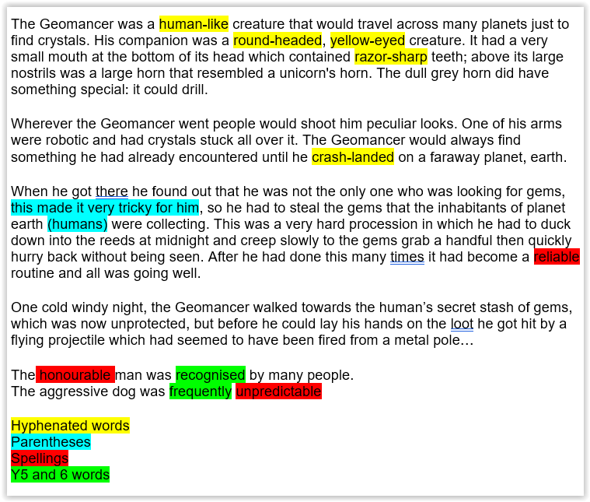

Slide 16
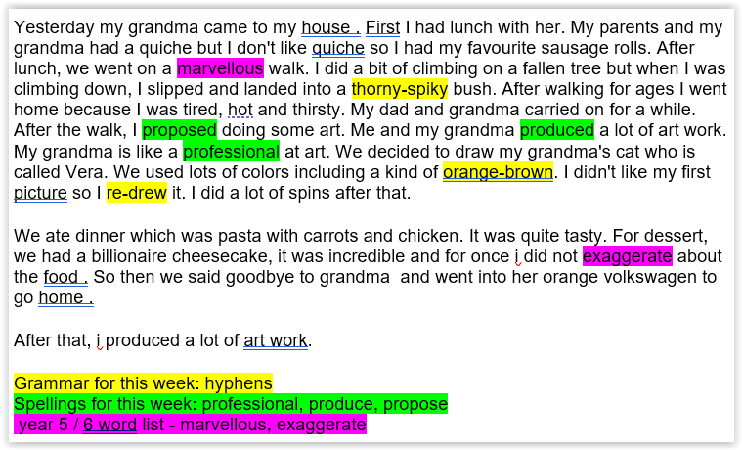

Slide 17
What can you do at home?
Please support your child in developing their independence
Guide your child, but please let them do their own work
Help your child develop resilience
Encourage completion of homework – support a work space and time
Read, read, read…then read some more!
Talk to your child about what they are reading – ask them questions, summarise, predict
Times tables – use them or lose them!
Talk to us with any concerns.
Allow your child some down-time!
Well-being comes first - a happy child is a successful child

Slide 18
We are a team!
We are here to support you and your child.
Please don’t hesitate to come and speak to us on the playground after school, drop us an email via the school office or make a request for an appointment for an in-person meeting or a phone call.

