Slide 1
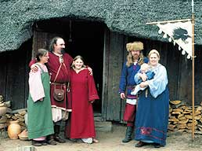
Viking jobs.
Few people in those days had what we think of as 'jobs' nowadays, i.e. working regular hours for a fixed sum of money, and working for someone else. Most people in those days, not just in the Viking world but in Europe generally, would be self-employed, working largely for their own benefit and at their own pace.
Notes:
1

Slide 2
Men worked on farms, or as craftsmen or traders. They handled boats for fishing or travelling. Sometimes a man had to fight to protect his family or to support his king or local chieftain (a village leader).
Notes:
2

Slide 3
Women did all the household jobs. They also helped on the farm, milked the cows and made cheese. They spun, wove and sewed all the family's clothes. Children did not go to school. They helped their parents at work, and learned about history, religion and the law from stories. They became adults at the age of 15 or 16.
Notes:
3

