Slide 1
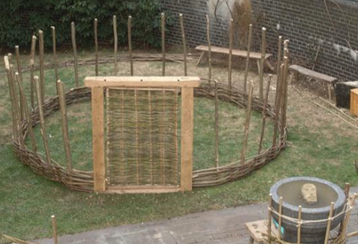
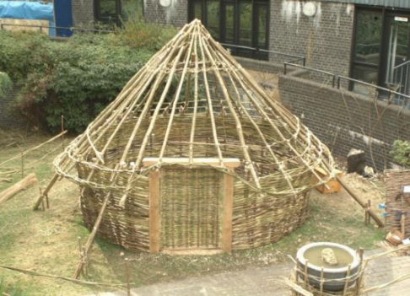
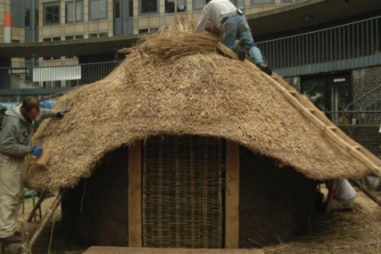
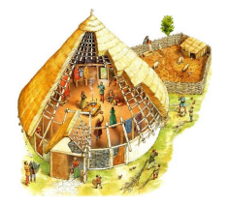
Making a roundhouse constructions
Design Technology
Year 3/4
Autumn 1
Cycle B
Key knowledge: How to make a roundhouse
Overview
During this topic we will be discovering thousands of years ago, during the Stone Age, humans lived in caves and jungles. During this period, there were two main things that people needed to do – to find and make shelter and to gather food. Hunter-gatherers, as they are sometimes referred to, often sheltered in caves but when there were no caves to live in, they would have to make their own shelters. They would need to be waterproof and windproof and they would use leaves, branches and animal skins. In this topic you will become a hunter-gatherer and design and make your own Stone Age shelter!
Create a wall line by inserting your ‘posts’ into your base. You’ll probably need to carefully cut a hole before putting the posts in. Secure with a little (non-authentic) tape or glue. 7 to 11 posts, each around 8cm long, should be fine with approximately 3cm spacing between them. Don’t forget to leave a bigger space on the south side for a main door.
A tightly woven wattle wall will help make your roundhouse a strong structure. Using string or wool, start on one of your door posts and weave in and out around your roundhouse covering the sides completely, starting from the bottom up to the top of the wall posts. Don’t forget to leave a gap for the door.
Next you need to lay long rafters so they come together at the top. Try to tie them together with string or wool (or else use a little glue or sellotape) at the top. Once secure, you can cut the length of the rafters so they overhang.
Daub is a mixture of soil with fibrous material to bind it together, such as straw. It’s used to give a waterproof coating to the woven wattle framework. You may want to try mixing your own daub or you could use clay. Stick it carefully on top of the woven wattle.
Topic vocabulary
Roundhouses were the standard form of housing built in Britain from the Bronze Age throughout the Iron Age, and in some areas well into the Sub Roman period. The people built walls made of either stone or of wooden posts joined by wattle-and-daub panels, and topped with a conical thatched roof.
Thatched roof Thatching is the craft of building a roof with dry vegetation such as straw, water reed, rushes, heather, or palm branches, layering the vegetation so as to shed water away from the inner roof.
Wattle and daub A material formerly or traditionally used in building walls, consisting of a network of interwoven sticks and twigs covered with mud or clay.
Central pole The roundhouse would, indeed, have a central post for support but only during construction. The main rafters would be attached to one or more circular ring beams high in the building which would also be attached to the central pole.
Fire It was quite dark inside the roundhouses with most of the light coming from the doorway during the day. In the centre of the roundhouses there were fireplaces.
Knowledge & Understanding
In this unit, the we will:
Use research and develop our own design for a prehistoric building (roundhouse).
Select from and use a wider range of tools and equipment to perform practical tasks [for example, cutting, shaping, joining and finishing], accurately.
Evaluate our ideas and products against our own design criteria and consider the views of our peers.
Apply our understanding of how to strengthen, stiffen and reinforce more complex structures
Did you know that the roundhouses first appeared in the Thames Valley over 3500 years ago? They were the main type of home in Britain right up until Roman times.
Cross Curricular links
History
Changes in Britain from the Stone Age to the Iron Age

