Slide 1
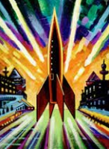
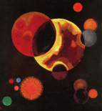
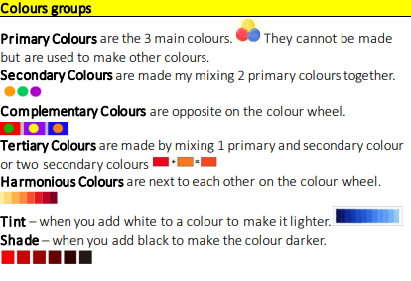
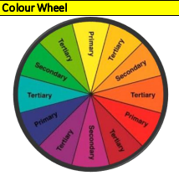
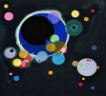
Abstract art
Art and Design
Year 5/6
Autumn 1
Cycle B
Overview
In this topic we will be learning about an established contemporary artist who specialises in Space themed paintings- Peter Thorpe. We will learn some facts about the life of Peter Thorpe, consider his style and express opinion of his work. We will also be looking at historical artists such as Wassily Kandinsky who were influenced by Space.
Key artists
Peter Thorpe– a contemporary artist who has always loved Space. He is best known for his bold, vivid paintings.
Wassily Kandinsky– a Russian, 19th Century artist who was one of the founders of abstract art. He was interested in shape and Space.
Knowledge & Understanding
In this unit, the we will:
Learn the effect of a range of painting techniques & materials-eg powder/ poster paint, flicking, dripping, splattering.
Use our sketchbooks when experimenting and planning a piece of work.
Use our knowledge of the Colour Wheel to aid composition planning e.g. primary, secondary, warm, cold and complimentary colours.
Evaluate an artist’s work as well as reflect on our own and peer’s final pieces.
Topic vocabulary
Abstract- art which doesn’t represent reality but rather uses shapes, colours and textures for an effect.
Realistic– art which represents things that are true to life.
Cartoon– a simplistic drawing/picture/painting Background– the part of a painting furthest away from the viewer.
Foreground- the part of a painting closest to the viewer.
Painting techniques- different methods of applying paint.
Did you know that abstract art is one of the only form s of art that can be considered truly modern?
The famous abstract art or expressionism movement didn't begin until the 1940s. This movement took place in the United States, specifically in New York City. After the Second World War, abstract art became a really dominant form of art across America.
Cross Curricular links
Science
Earth and space
Light

