Slide 2
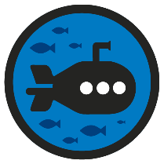
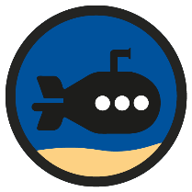
Diving into Mastery Guidance for Educators
Each activity sheet is split into three sections, diving, deeper and deepest, which are represented by the following icons:
These carefully designed activities take your children through a learning journey, initially ensuring they are fluent with the key concept being taught; then applying this to a range of reasoning and problem-solving activities.
These sheets might not necessarily be used in a linear way. Some children might begin at the ‘Deeper’ section and in fact, others may ‘dive straight in’ to the ‘Deepest’ section if they have already mastered the skill and are applying this to show their depth of understanding.
Diving
Deeper
Deepest

Slide 3
National Curriculum Objective
Draw given angles and measure them in degrees.

Slide 4
Measuring with a Protractor (2)
Diving
Estimate these angles.
38°
135°
280°
Were your estimates near?
What angles knowledge did you use to help you?

Slide 5
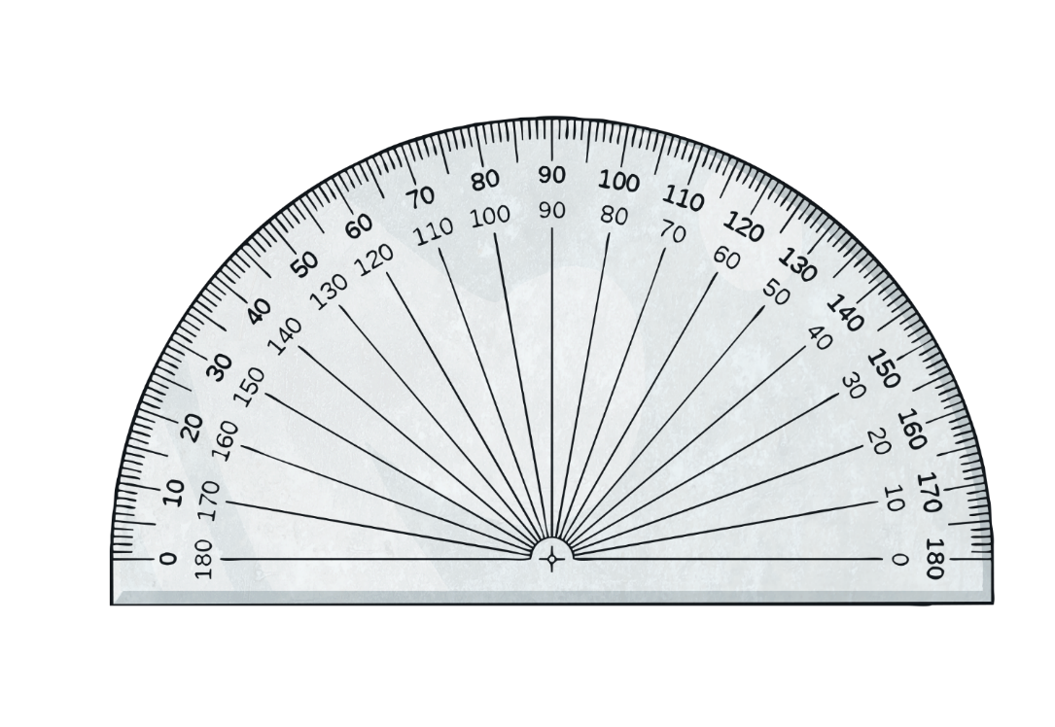
Measuring with a Protractor (2)
Deeper
Here is a reflex angle. How would you use a protractor to measure this accurately? Discuss with your learning partner.
Both angles have a sum of 360°. Using your knowledge of a full turn being 360°, you could measure the acute angle and then subtract this from 360°.

Slide 6
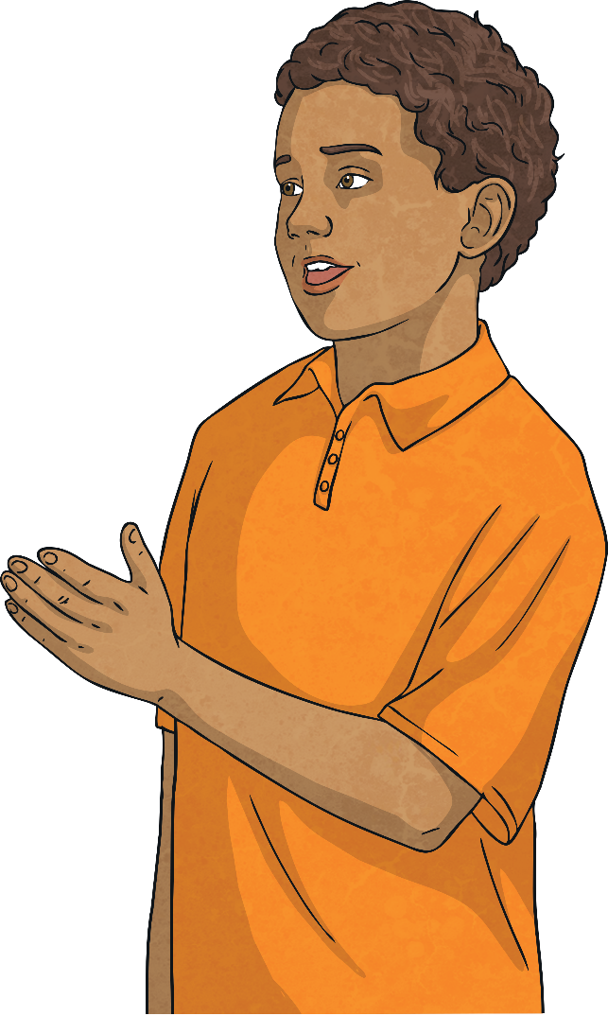
Measuring with a Protractor (2)
Deepest
Is this statement always, sometimes or never true?
Two obtuse angles make a reflex angle.
This is always true.
The greatest angle you can make with two obtuse angles is 179° x 2 = 358° which is a reflex angle.
The smallest angle that can be made with two obtuse angles is 91° x 2 = 182° which is also a reflex angle.

Slide 7
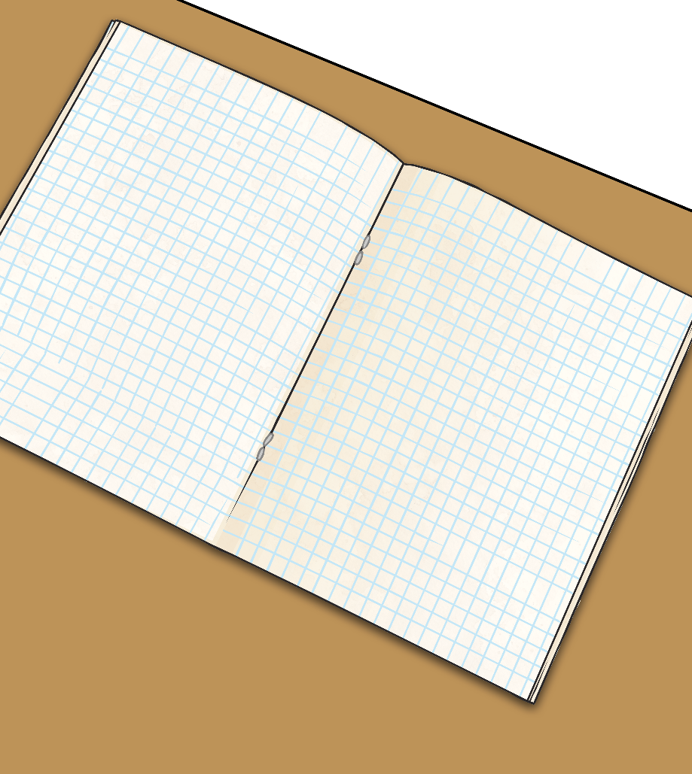
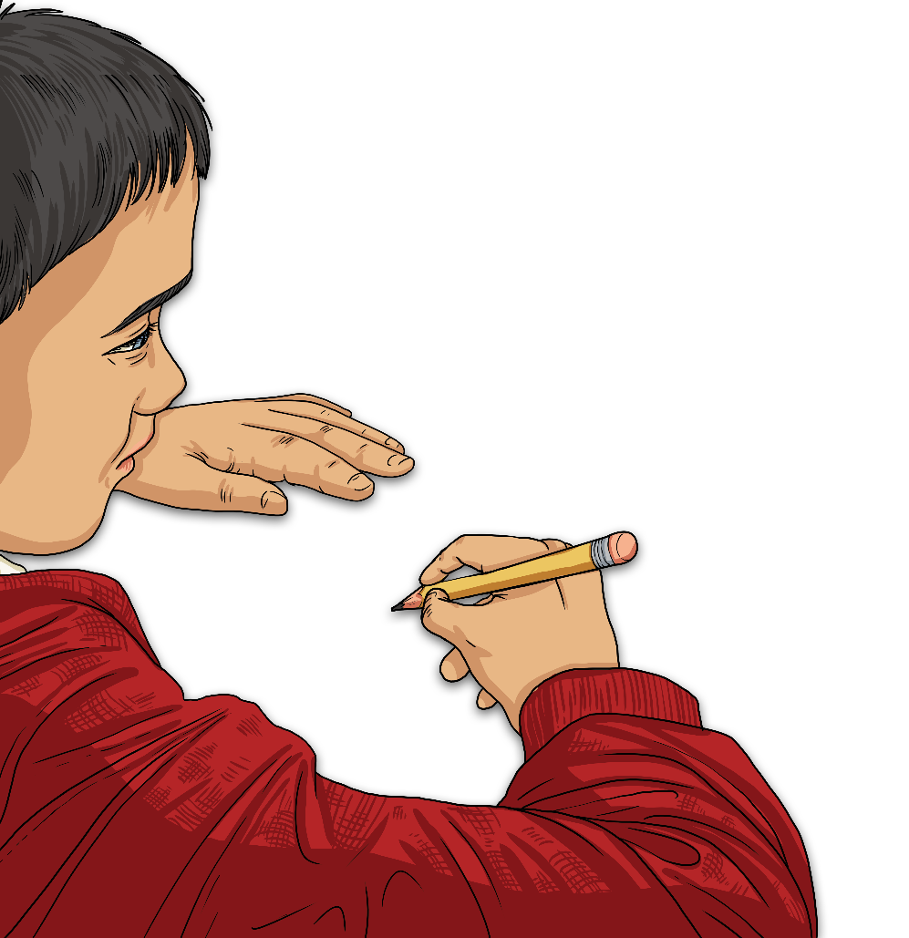
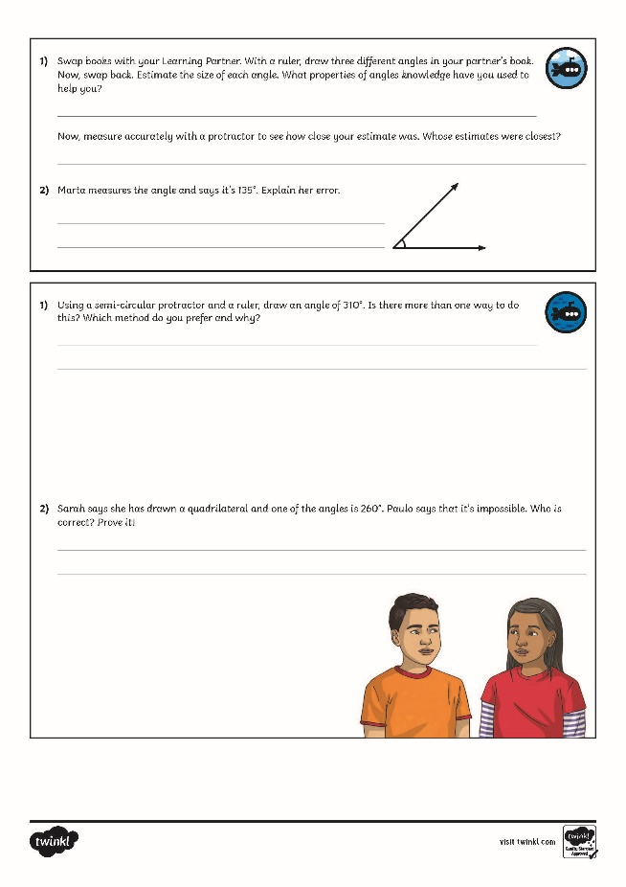
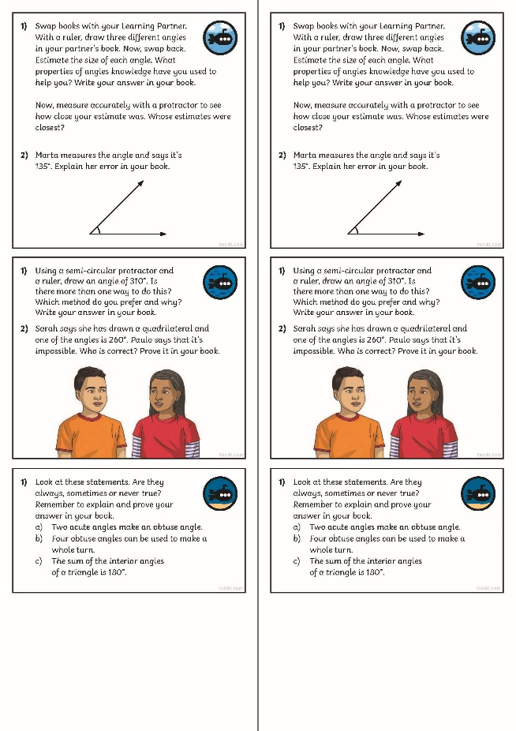
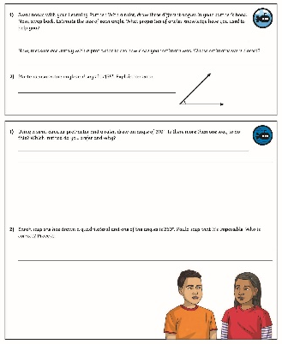
Measuring with a Protractor (2)
Dive in by completing your own activity!

Slide 8
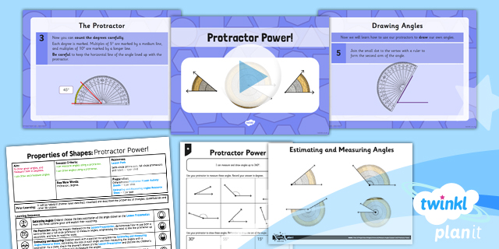
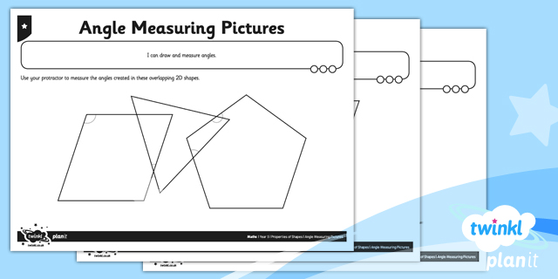
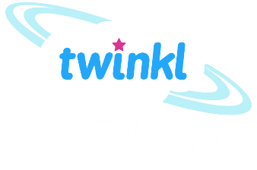
Need Planning to Complement this Resource?
National Curriculum Aim
Draw given angles and measure them in degrees.
For more planning resources to support this aim, click here.
Twinkl PlanIt is our award-winning scheme of work with over 4000 resources.

